Slide 1
MultiChain Consumption
Meeting: 28.02.2018

Slide 2
Agenda
Explain MultiChain
Explain MultiChain Service Architecture
SAP Cloud Platform Blockchain - MultiChain
Demo the consumption of the MultiChain service

Slide 3
Explain MultiChain
https://www.multichain.com/
MultiChain helps organizations to build and deploy blockchain applications with speed.

Slide 4
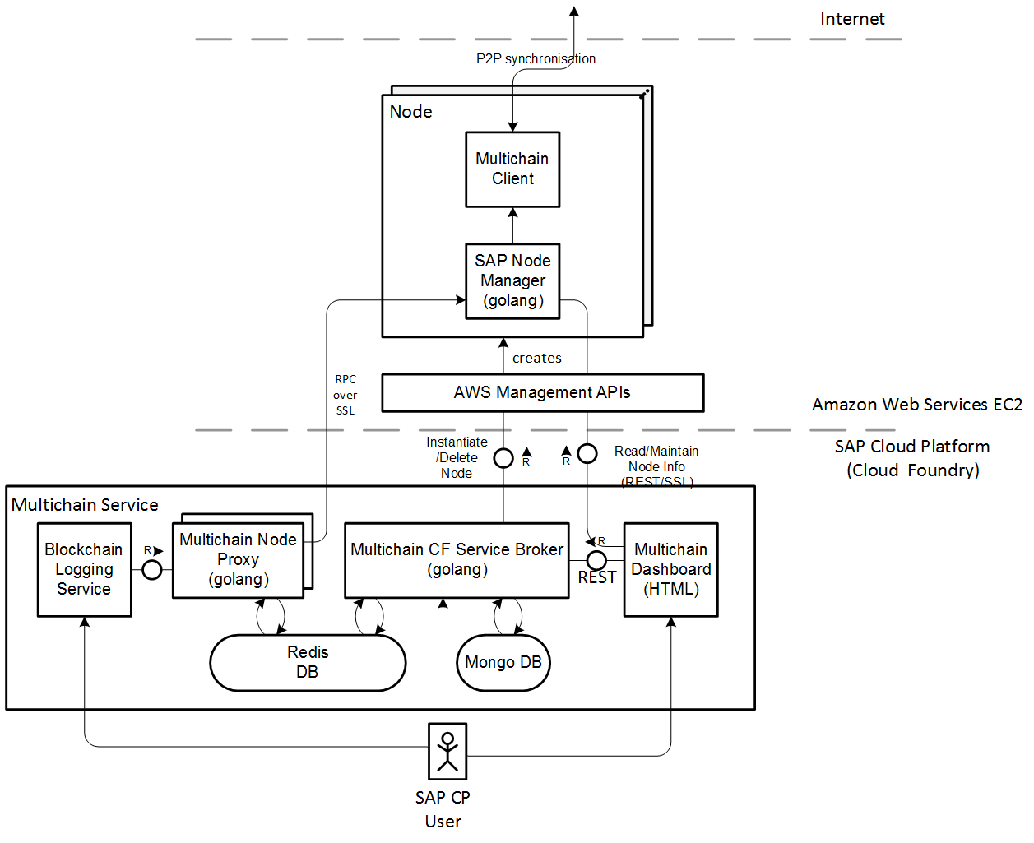
Explain MultiChain Service Architecture

Slide 5
SAP Cloud Platform Blockchain MultiChain
MultiChain is a “pure” blockchain based (forked from) Bitcoin protocol. It supports use cases without smart contracts and focusing on Data Storage & Retrieval and Asset Transfer
Highlights
Get your own multichain instance with MultiChain Service
Bind your application and use json-rpc to connect to the node
Easily build up your own network of multichain nodes. Connect to nodes on other SAP Cloud Platform accounts or on any multichain nodes via Internet
Explore the data on the multichain node/network using the SAP Multichain Dashboard

Slide 6
Consumption of the MultiChain service
Follow Hands-On documents: https://jam4.sapjam.com/groups/5yjoVnClxw91MBszN8mO6c/overview_page/GuhOBeBZTA2VuXNJ3baIex?edit_mode=true
Setup
Enable Multichain Service in Canary
Create your first Multichain Node
Build up your own Multichain network
Use Cases
Asset Transfer Scenario using multiple addresses on your node
Data Storage and Retrieval using Multichain Streams

Slide 7
Roadmap – SAP Cloud Platform Blockchain
February 2018 – Landscapes: EU10 (AWS) and US10 (AWS)
MultiChain: Beta
Hyperledger-Fabric: Beta
July 2018: EU10 (AWS) and US10 (AWS)
MultiChain: GA
Hyperledger-Fabrix: GA

Slide 8
Appendix

